Slide 1

DC Circuits
Basic Laws
By Dr. Ahmed S. Abdullah
د. احمد سليمان عبدالله

Slide 2

Ohm’s law states that the voltage E across a resistor is directly proportional to the current I ﬂowing through the resistor.
That is,
E is the voltage in volts,
R is the resistance in ohms,
I is the current in amperes.
Georg Simon Ohm
In 1827

Slide 3
From this, you can see that the larger the applied voltage, the larger the current, while the larger the resistance, the smaller the current.

Slide 4
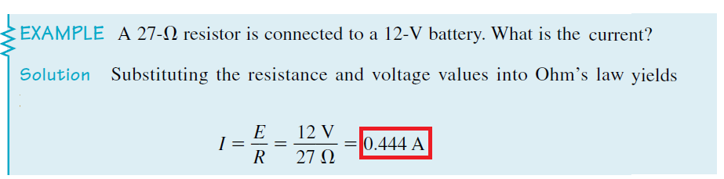
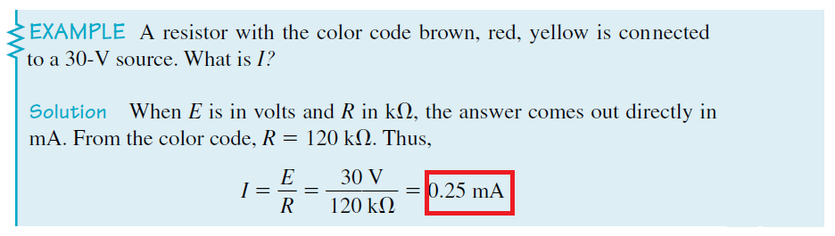

Slide 5
Branches, Nodes, and Loops
A branch represents a single element such as a voltage source or a resistor.
A node is the point of connection between two or more branches.
A loop is any closed path in a circuit.

Slide 6
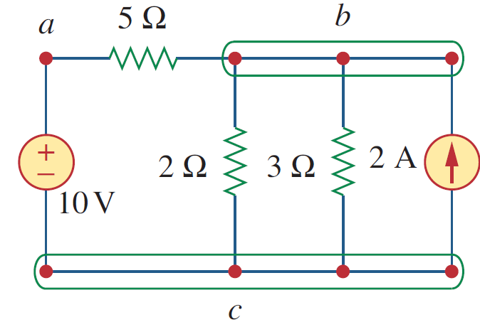
Branches, Nodes, and Loops
Example:- For the circuit shown, determine the number of branches, nodes, and independent loops.

Slide 7
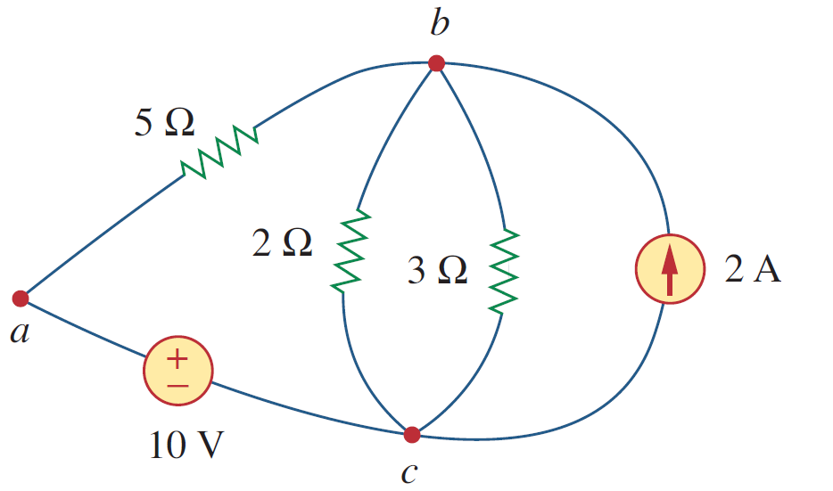
Branches, Nodes, and Loops
Example:- For the circuit shown, determine the number of branches, nodes, and independent loops.

Slide 8
Branches, Nodes, and Loops
Example:- For the circuit shown, determine the number of branches, nodes, and independent loops.
Solution:-
A branch represents any two-terminal element. The circuit in Figure shown has five branches, namely, the 10-V voltage source, the 2-A current source, and the three resistors.

Slide 9
Branches, Nodes, and Loops
Example:- For the circuit shown, determine the number of branches, nodes, and independent loops.
Solution:-
A branch represents any two-terminal element. The circuit in Figure shown has five branches, namely, the 10-V voltage source, the 2-A current source, and the three resistors.
And has three nodes a, b, and c.

Slide 10
Branches, Nodes, and Loops
Example:- For the circuit shown, determine the number of branches, nodes, and independent loops.
Solution:-
A branch represents any two-terminal element. The circuit in Figure shown has five branches, namely, the 10-V voltage source, the 2-A current source, and the three resistors.
And has three nodes a, b, and c.
In the Figure, the first loop is abca with the 2Ω and 5 Ω resistors and voltage source is independent. A second loop with the 3Ω resistor and the current source is independent. The third loop could be the one with the 2Ω resistor in parallel with the 3Ω resistor. This does form an independent set of loops.

Slide 11


Branches, Nodes, and Loops
Example:- For the circuit shown, determine the number of branches, nodes, and independent loops.
Solution:-
A branch represents any two-terminal element. The circuit in Figure shown has five branches, namely, the 10-V voltage source, the 2-A current source, and the three resistors.
And has three nodes a, b, and c.
In the Figure, the first loop is abca with the 2Ω and 5 Ω resistors and voltage source is independent. A second loop with the 3Ω resistor and the current source is independent. The third loop could be the one with the 2Ω resistor in parallel with the 3Ω resistor. This does form an independent set of loops.
Check:- b= 5 , n= 3, and l = 3
$$b=l+n−1$$
5 $=3+3−1$

Slide 12
Kirchhoff’s Laws
Kirchhoff’s voltage law (KVL) states that the algebraic sum of all voltages around a closed path (or loop) is zero.
Kirchhoff’s current law (KCL) states that the algebraic sum of currents entering a node (or a closed boundary) is zero.
Gustav Robert Kirchhoff

Slide 13
References
Boylestad, Robert L. Introductory circuit analysis. Pearson Education, 2010.
Robbins, Allan H., and Wilhelm C. Miller. Circuit analysis: Theory and practice. Cengage Learning, 2012.
Sadiku, Matthew NO, and Chales K. Alexander. Fundamentals of electric circuits. McGraw-Hill Higher Education, 2007.

